Slide 1

Frankfurt University of Applied Sciences
Analysing parameters of an HTM system, implemented for image classification
Subject : Software Engineering
By : Damir Dobric / Andreas Pech
Team : Metaverse
Team Members :
Mahdieh Pirmoradian
Omid Nikbakht

Slide 2
Analysing parameters of an HTM system, implemented for image classification
Introduction(HTM, Image Classification)
Methodology
Experiments
Discussion
Conclusion

Slide 3
Why Image Classification?
To classify a huge amount of visual data
The majority of visual data could be sensitive information.
The approach is instead of storing them in databases
to analyze them in the real time by online models
make predictions and detections from them.

Slide 4
Why HTM?
The used model for this purpose should be:
Fast
Precise Prediction
Algorithms that use a more realistic neural model would produce stronger AI, so
HTM was proposed.
Learns from a stream of online data (online means in real time)
It saves a lot of memory because of the use of SDRs.
SDRs can be significantly more noise-resistant than dense representations

Slide 5
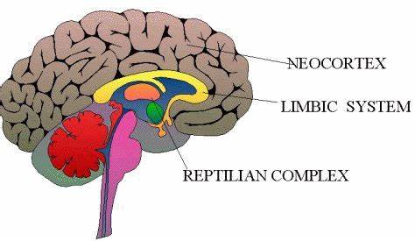
What is HTM?
Inspired from the Neocortex of the human brain.
Neocortex part of the brain controls many vital processes
in our actions and behavior.
Figure 1: Structure of Brain

Slide 6
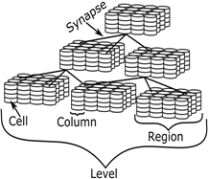
HTM
HTM, like the neocortex, consists of identical regions
Cell
Column
Region
HTM Layer
Figure 2: HTM Hierarchy

Slide 7
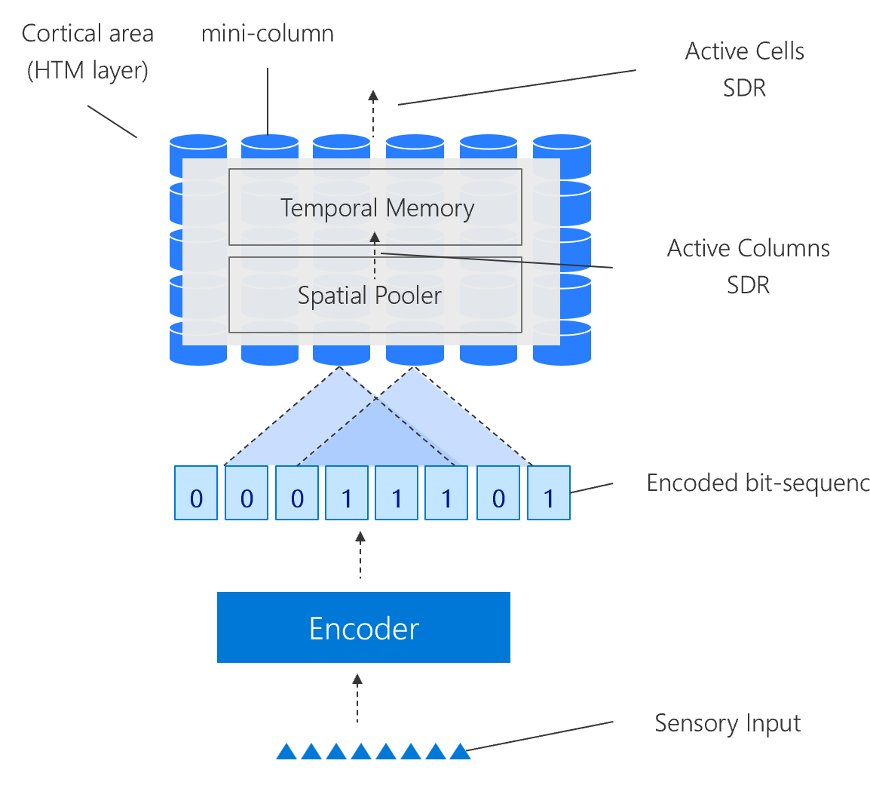
HTM function
The general overview of how HTM functions
Encoding entry data
Spatial pooling encoded data into system
Prediction and classifying the data
Figure 3: How HTM works

Slide 8
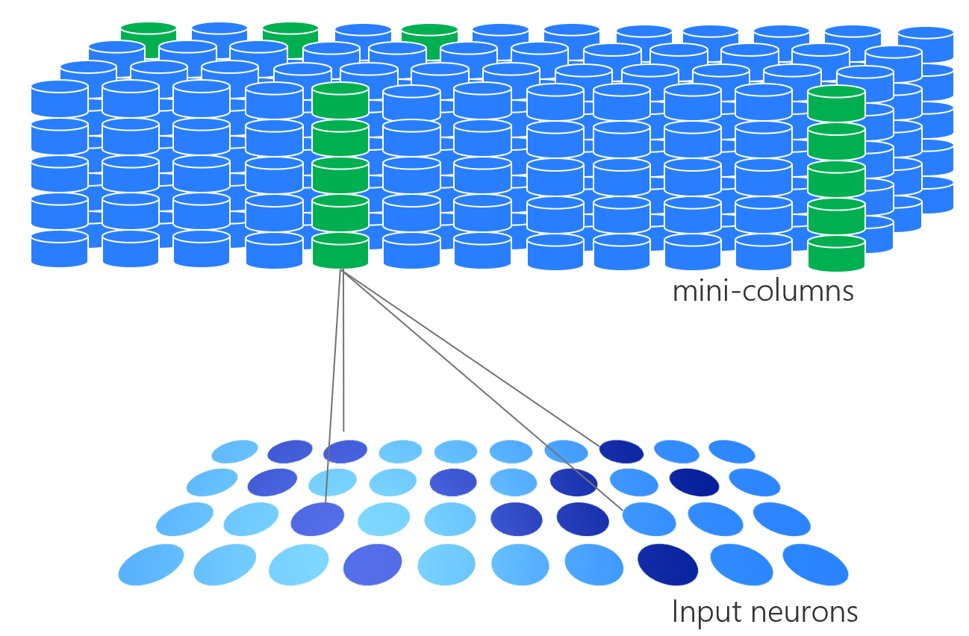
HTM function
The spatial pooler pooling the semantic information of entry data into system
Overlap calculation
Activating columns (2% sparsity)
Figure 4 spatial pooler

Slide 9
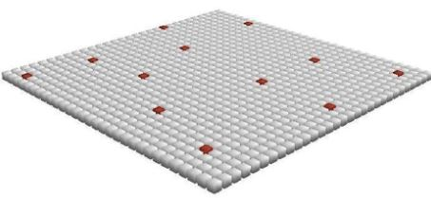
HTM function
Looking at the layer of mini-columns from above lets us see the unique SDR produced by HTM for each entry input
2% sparsity inspired from Neocortex
Extremely high capacity of information storage
Noise robustness
Figure 5 SDR

Slide 10
Methodology (Project Description)
Finding most efficient parameters of an HTM system, implemented for image classification.
Over 100 Experiments done.
The results of experiments illustrated in graphical representations.
A prediction code is added, so that the trained HTM system can recognize similarity of an input test image to the trained image categories.
max
min similarity of input test image to the trained categories.
average

Slide 11
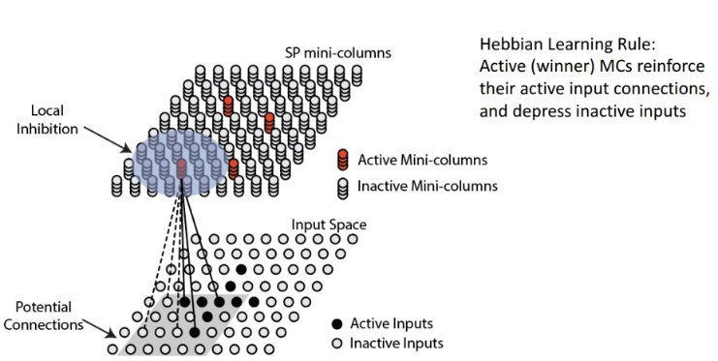
Methodology
The parameters of HTM which are investigated in this Project
PotencialRadius
localAreaDensity
NumActiveColumnsPerInhArea
GlobalInhibition
Figure 6 working illustration of spatial pooler

Slide 12
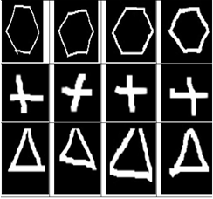
Methodology
Three categories of images for training the HTM system
Input dataset will be encoded, and semantic characteristics of each input will be pooled into HTM by spatial pooler.
Figure 6 Input training Images

Slide 13
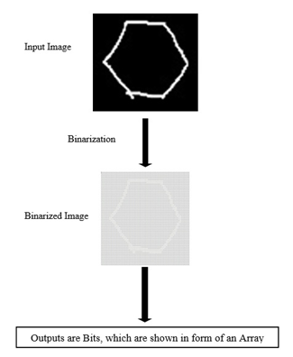
Methodology
Preparing and standardizing inputs by an encoder (Binarization of input) returning 1s and 0s.
This representation of entry data is a Sparse Distributed Representation of data also called SDR.
Figure 7 Image Binarization

Slide 14
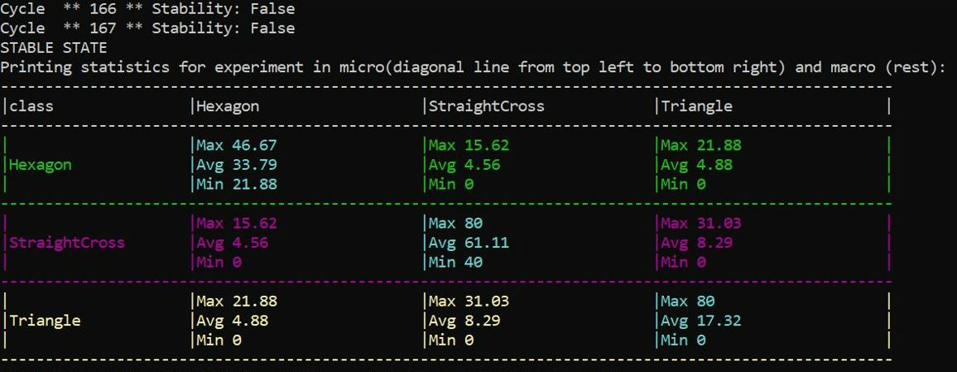
Methodology
Comparing the output SDRs of each entry to others After training the HTM,
This comparison helps the system differentiate images from each other or find similarities between them
Figure 17: the macro and micro similarity after training the system (Output Similarity)

Slide 15
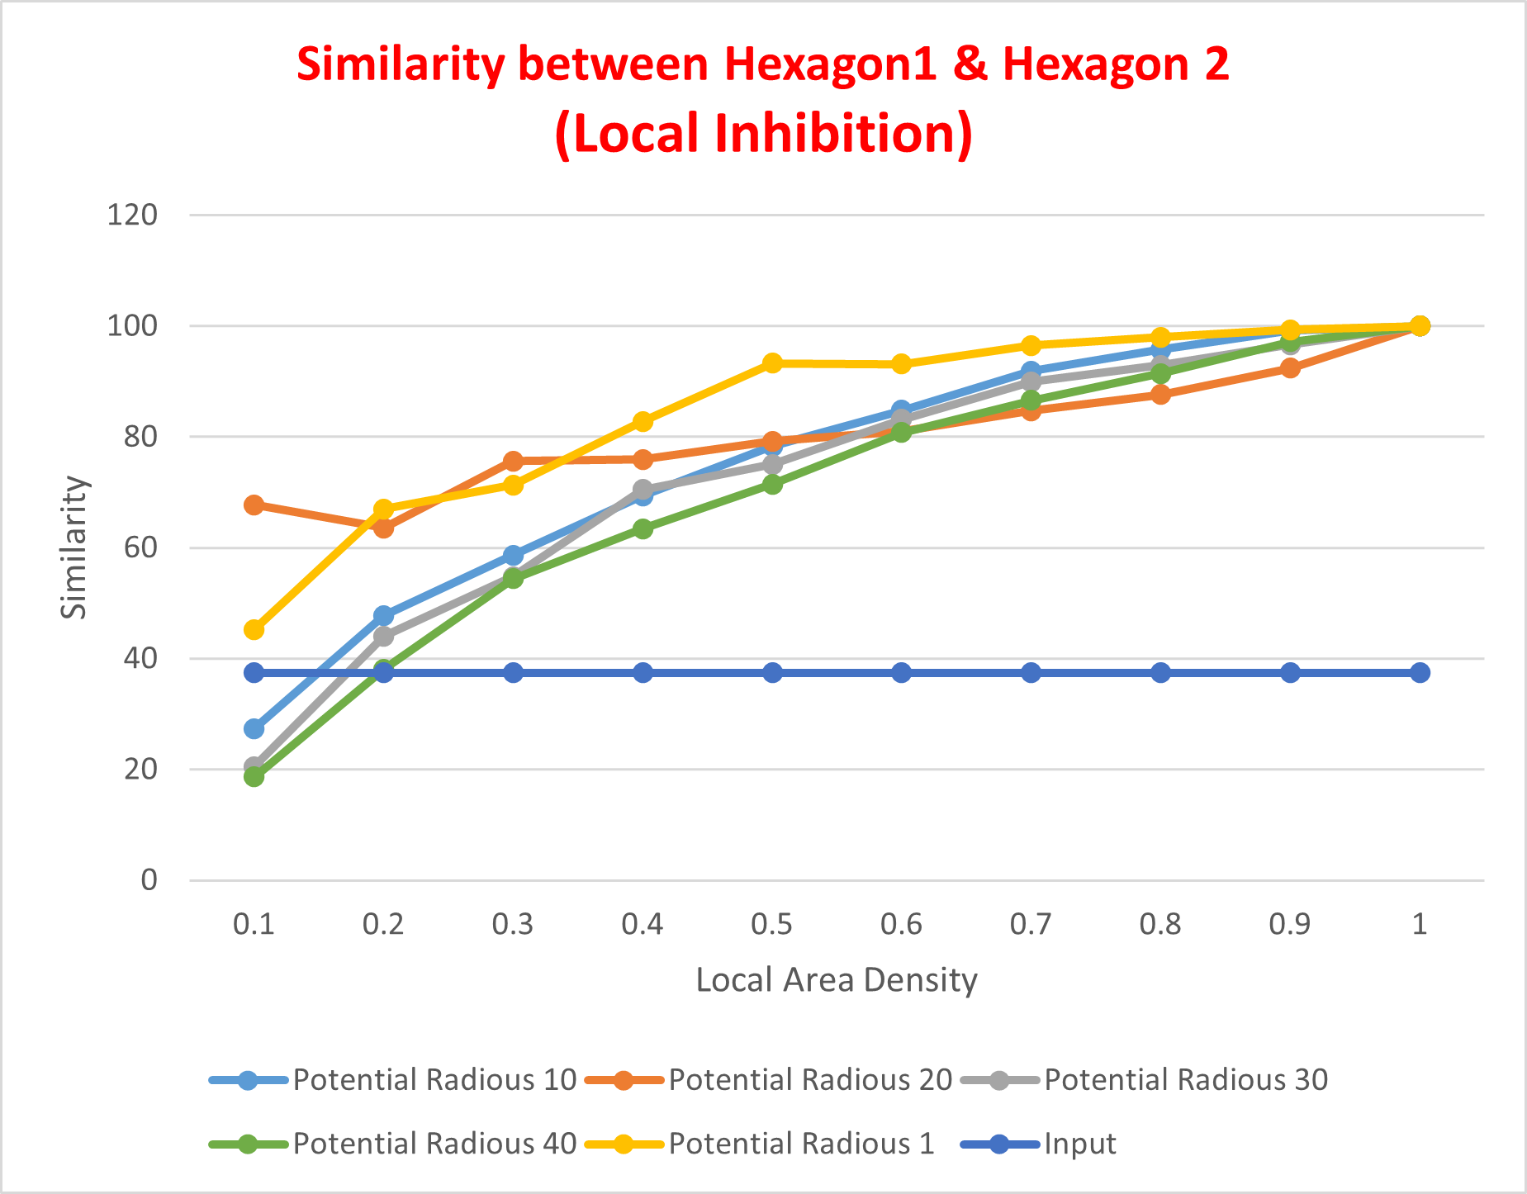
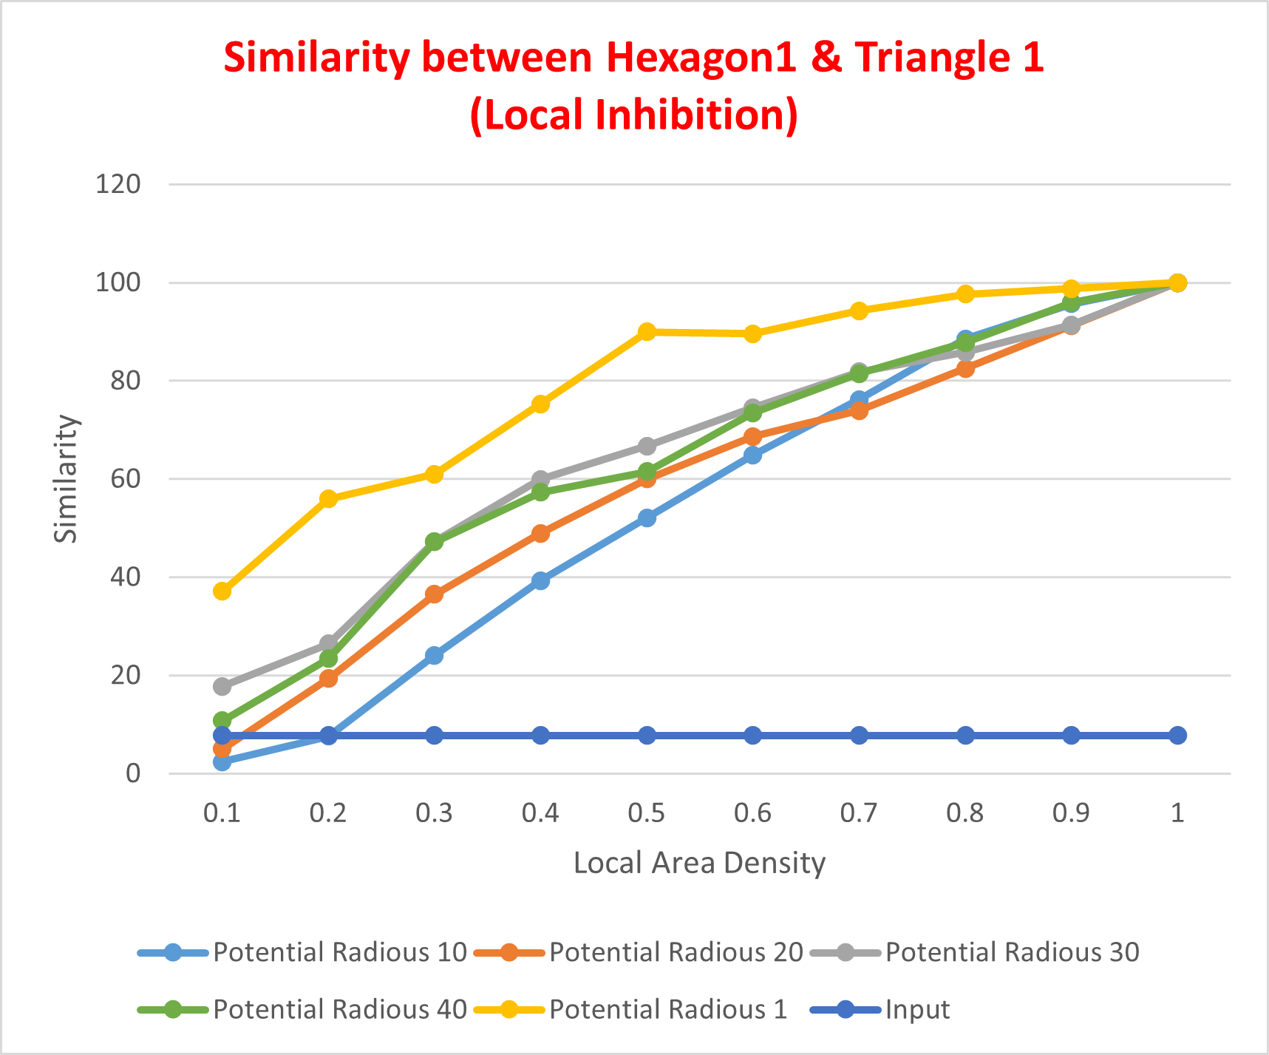
Experiments
Choosing the sufficient PotencialRadius parameter
A potencialRadius of 20 could be a good choice
Figure 8 similarity between Hexagon1 and Hexagon2 (with Local Area Inhibition)
Figure 9 Image Binarization similarity between Hexagon and Triangle (with Local Area Inhibition)

Slide 16
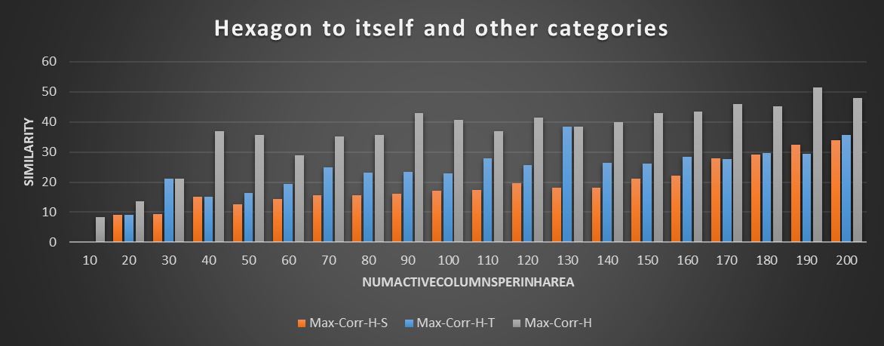
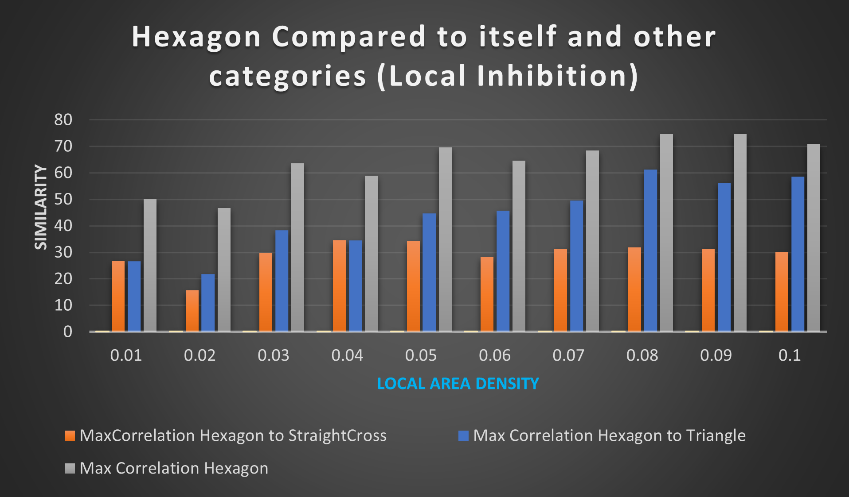
Experiments
Comparing results of using localAreaDensity and NumActiveColumnsPerInhArea
Figure 10 the Max-similarity of Hexagon category to itself compared to Max-similarity of Hexagon to other categories varying NumActiveColumnsPerInhArea from 10 to 200 (with Local Area Inhibition)
Figure 11 the Max-similarity of Hexagon category to itself compared to Max-similarity of Hexagon to other categories varying localAreaDensity from 0.01 to 0.1 (with Local Area Inhibition)
These two parameters both refer to sparsity of SDRs and lower values shows better functionality for both of them

Slide 17
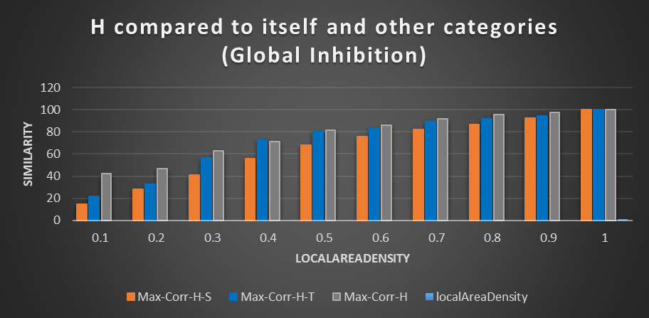
Experiments
Implementing GlobalInhibition does not provide us with acceptable results
Figure 12: the Max-similarity of Hexagon category to itself compared to Max-similarity of Hexagon to other categories varying localAreaDensity from 0.1 to 1 (with Global Inhibition)

Slide 18
Discussion
Choosing the desired parameters
Adding more images to each category of training dataset
Testing the functionality of system with input test images
Table 1: The chosen parameters of HTM

Slide 19
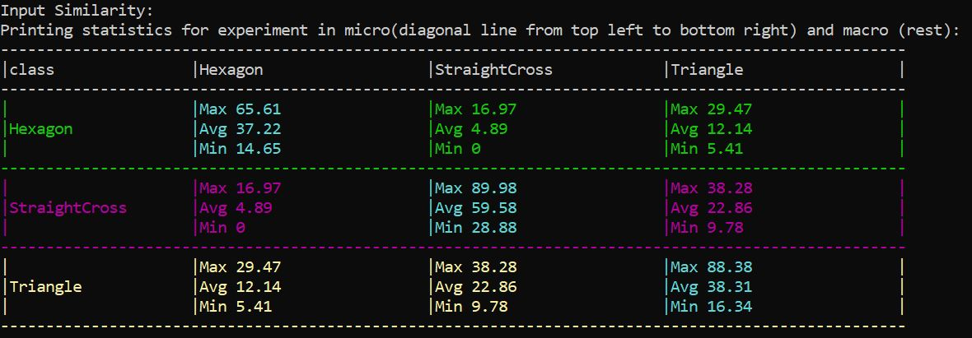
Discussion
The similarity comparison between input images of training data set before the system is trained
Figure 13: the macro and micro similarity before training the system (Input Similarity)

Slide 20
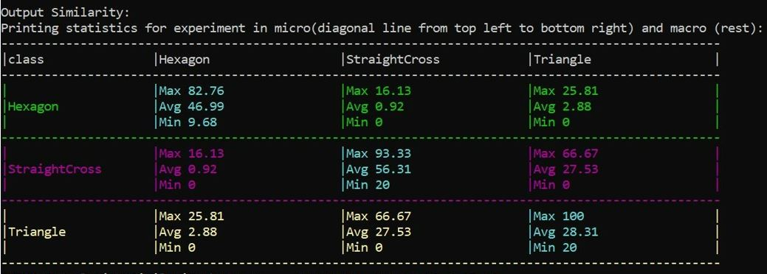
Discussion
How similar does the HTM see the input images dataset to each other, after the system is trained
HTM sees images of same categories more similar to each other after it is trained with the input dataset images.
Figure 14: the macro and micro similarity after training the system (Output Similarity)

Slide 21
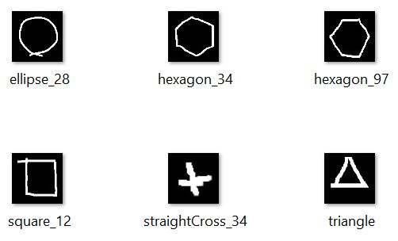
Discussion
giving the system some test input images
some images are from the same category of input image dataset, with which the system is trained, and some don’t belong to any of the trained categories
Figure 15: Input Test Images

Slide 22
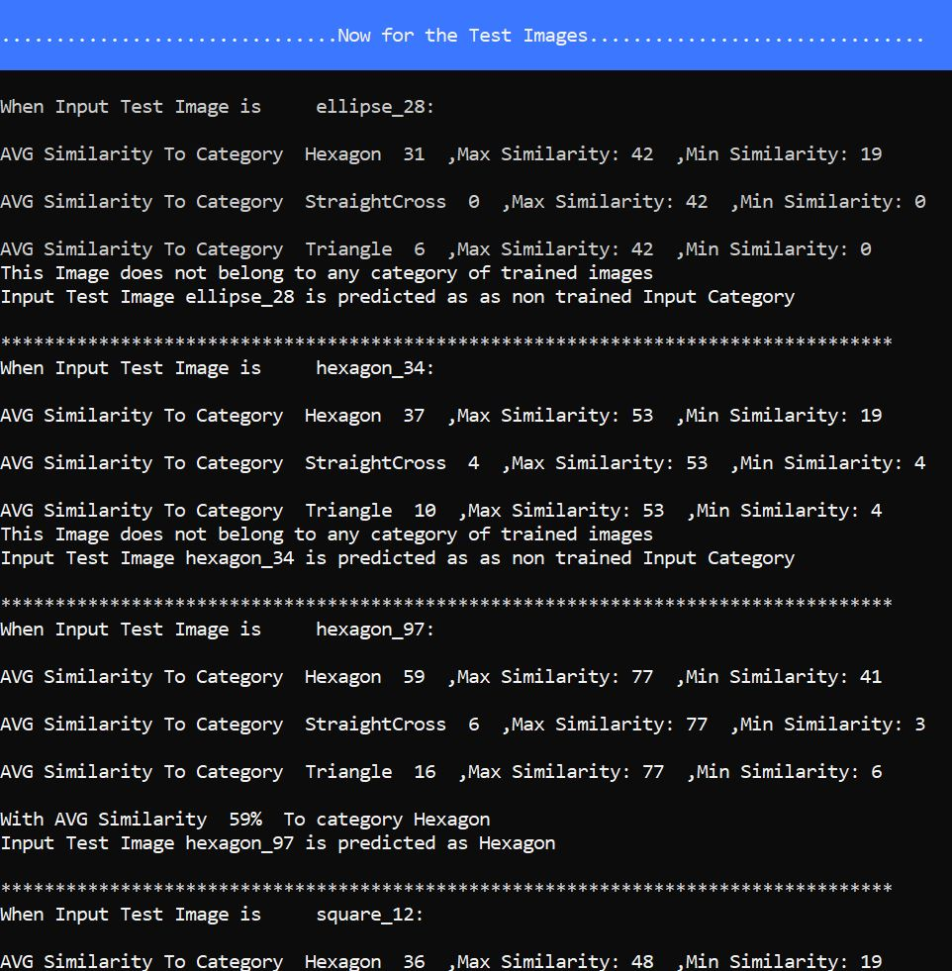
Discussion (The prediction results)
Maximum minimum and average similarity comparison is illustrated.
For the images which don’t belong to any of the training datasets categories, no category is chosen.
The images which, according to average calculated similarity, belong to a category of training images dataset, the recognized categories are mentioned.
Figure 16: Prediction Results

Slide 23
Conclusion
Generally, changing PotencialRadius and localAreaDensity values, cause more significant changes in the output result and that’s the reason why in the last final experiments it’s tried to configure the HTM parameters, according to these two.
Very high locaAreadensity values are not recommended.
This experiment was done for grayscale images, doing the same experiment for Colorful images is recommended.

Slide 24
Thank you
for your attention
If you have any question, you can contact us:
mahdieh.pirmoradian@stud.fra-uas.de
omid.nikbakht@stud.fra-uas.de

Slide 25
Sources
Figure 1: https://www.semanticscholar.org/paper/An-application-of-brain-based-education-principles-Roux-Joy/0814b1f139d58d923067d7172534f31c0bbd391b
Figure 2: https://www.frontiersin.org/articles/10.3389/frobt.2016.00081/full
Figure 3, 4: https://ddobric.github.io/neocortexapi/
Figure 5: https://www.analyticsvidhya.com/blog/2018/05/alternative-deep-learning-hierarchical-temporal-memory-htm-unsupervised-learning/
Figure 6: S. A.-Y. Cui, "The HTM Spatial Pooler—A Neocortical Algorithm for Online Sparse Distributed Coding," Frontiers in Computational Neuroscience, 2017
Figure 7 to 17 : belongs to our Experiment results

